Slide 1
FINAL Exercise
TA Time

Slide 2
Outline
俞
A
C
E
G
謝
D
F
B

Slide 3
11758 - A - Markov Matrix
Statement
X_{n+1} = Ax_{n} (A represents transition matrix, Xn represents state now)
Output
Please output how many years it takes to let the first city’s population to drop below p, or output "Never" if it will never drop below p after reaching steady state.

Slide 4
11758 - A - Markov Matrix
Matrix multiplication
Check first element
Idle -> print “Never”
Less than p -> print “years”

Slide 5
11760 - C - Stable Sort
Statement
Given a list of students and their score, you have to sort their score in decreasing order.
Stable sort
That is, if whenever there are two students A and B with the same score and with A appearing before B in the original list, A will appear before B in the sorted list.
Ex: bubble sort, insertion sort, merge sort
Unstable sort examples: quick sort, selection sort

Slide 6
11762 - E - Reverse Linked List
Statement
Implement 4 functions
Output the reversed linked list

Slide 7
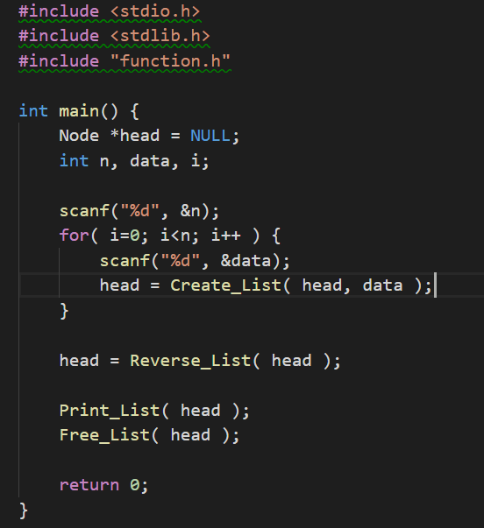
11762 - E - Reverse Linked List

Slide 8
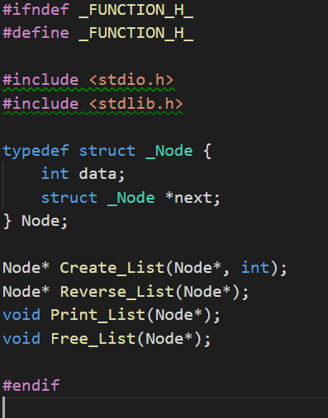
11762 - E - Reverse Linked List

Slide 9
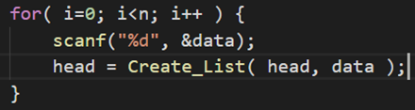
11762 - E - Reverse Linked List
Node* Create_List(Node *head, int n)
Step 1：Create a node (assign value n)
Step 2：find the end of linked list, append the node you just create
Step 3：return linked list’s head
Notice：”return head” is always linked list’s head

Slide 10
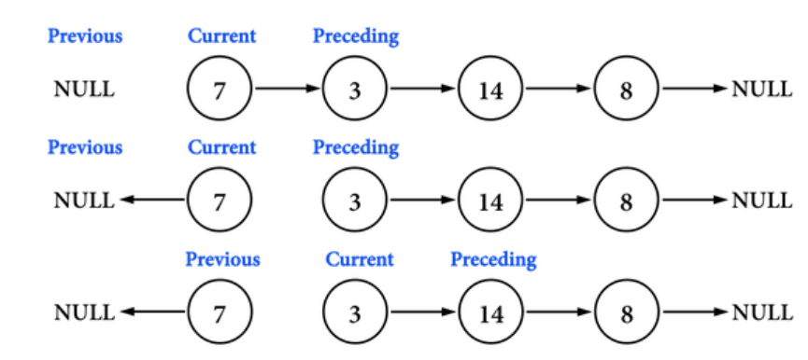
11762 - E - Reverse Linked List
Node* Reverse_List(Node *head)
Step 1： find preceding node
Step 2： current node points to precious node
Step 3： update previous, preceding, current

Slide 11
11762 - E - Reverse Linked List
void Print_List(Node *head)
Step 1：print head->data
Step 2：head = head->next
Please deal with last node

Slide 12
11762 - E - Reverse Linked List
void Free_List(Node* head)
Step 1：get head_next and record
Step 2：free head
Step 3：head = head_next

Slide 13
11770 - G - XOR
Statement
Given n numbers, you need to find a number k such that SUM is minimum,
where we define SUM = ( a₁ ^ k ) + ( a₂ ^ k ) + ... + ( a_{n} ^ k )
Thought
Disassemble a_{i} and k into bit presentation
For each bit, find out the desired k → (Which bit can make sum bit minimum now?)
Tips
Exclusive or sage: a[i] ^ k

Slide 14
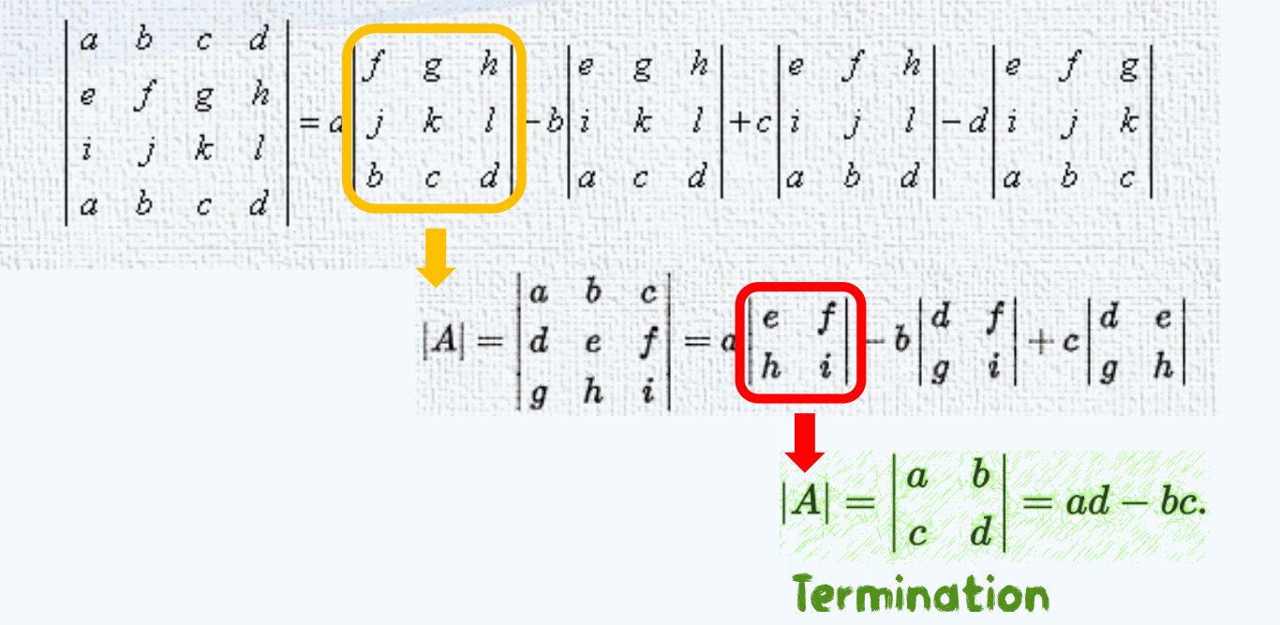
11761 - D - Determinant

Slide 15
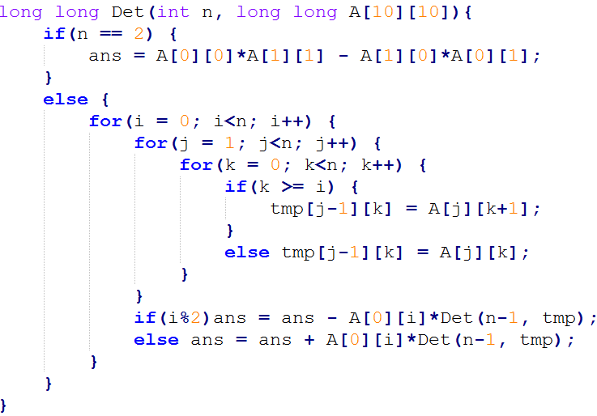
11761 - D - Determinant

Slide 16
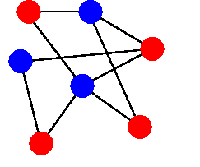

11763 - F - Bipartite Graph
Any two adjacent vertices need to have different color

Slide 17
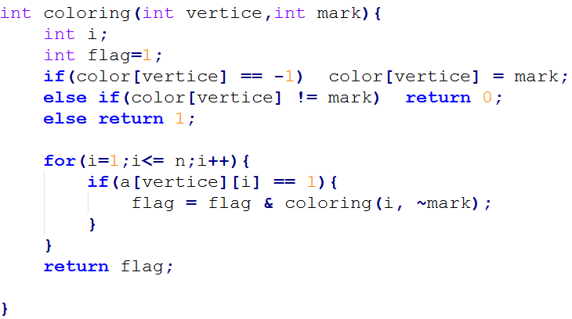
11763 - F - Bipartite Graph

Slide 18

11759 - B - Great Depression Again

Slide 19

11759 - B - Great Depression Again
數個可製作A和B的工廠
不重複挑選，X個製作A，Y個製作B
總價值最高
若有多種組合，則以A的總價值最高為答

Slide 20
11759 - B - Great Depression Again
挑選3個A，4個B
A B
TOYOTA 10 100
GM 20 90
FORD 30 80
Volkswagen 40 70
Daimler 50 60
Honda 60 50
Nissan 70 40
PEUGEOT 80 30
FIAT 90 20
BMW 100 10
A
BMW
FIAT
PEUGEOT
100 + 90 + 80 = 270
B
FORD
GM
TOYOTA
Volkswagen
80 + 90 + 100 + 70 = 3400

Slide 21
11759 - B - Great Depression Again
挑選1個A，1個B
A B
a 1001 1001
b 1000 1
c 1002 2000
A
a
1001
B
c
2000

Slide 22
11759 - B - Great Depression Again
Sorted by (A-B)
X + Y = n
BIG
SMALL
MIDDLE
X Produce A
Y Produce B

Slide 23
11759 - B - Great Depression Again
But,
X+Y <= n
BIG
SMALL
X Produce A
?????
Y Produce B

Slide 24
11759 - B - Great Depression Again
BIG
SMALL
MIDDLE
MIDDLE
Sort By A
Sort By B
X
Calculate total value
Y

Slide 25
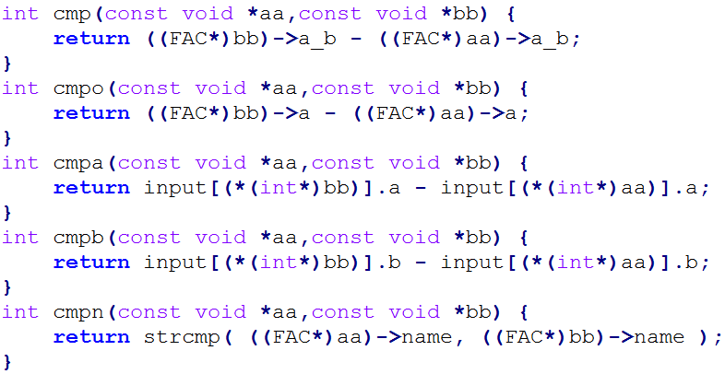
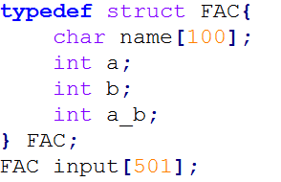
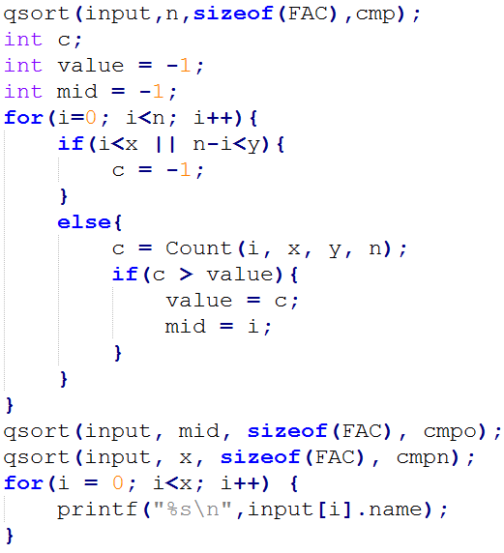
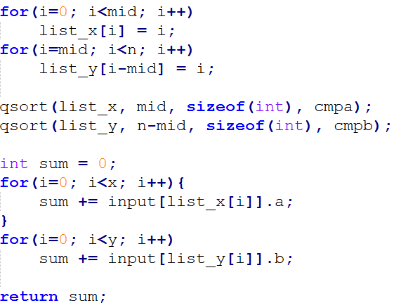

Slide 26
NOtice
期末考
1/12 星期五 晚上 6：30～10：00
包含本學期教學範圍
五道正式考題，一道額外的加分題
期末Project DEMO
1/15 星期一 早上 8：00～12：00
採隨機DEMO順序
請盡早過來做準備
以上若有人無法，或有問題，請立刻告知我們

Slide 27




Slide 28

Last roll call

Slide 29


Better our Lives

